Slide 1
Vancouver: a Sustainable Settlement?
Dr Paul McKenzie
School of Geography and Environmental Sciences
A “Whistler” stop tour!?

Slide 2
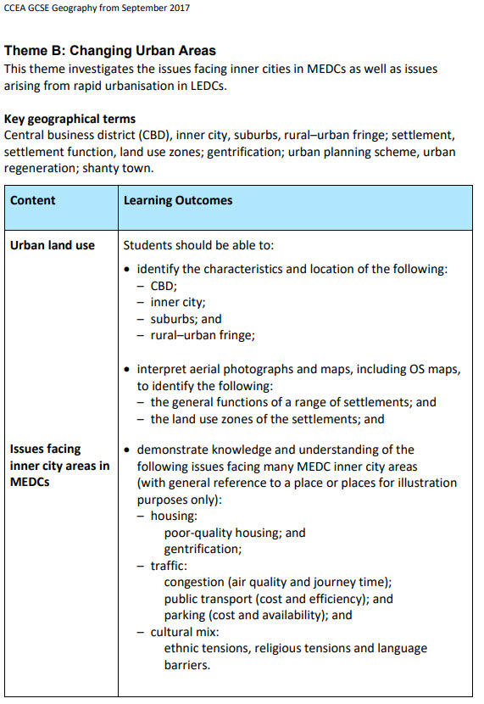
Alignment to specification – GCSE

Slide 3
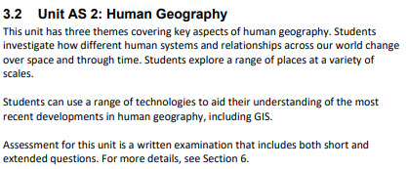
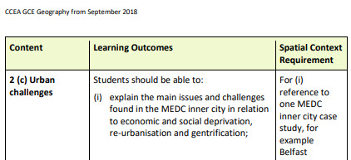
Alignment to specification – AS

Slide 4
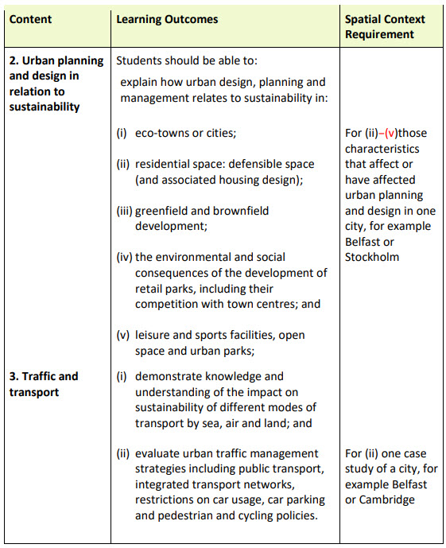
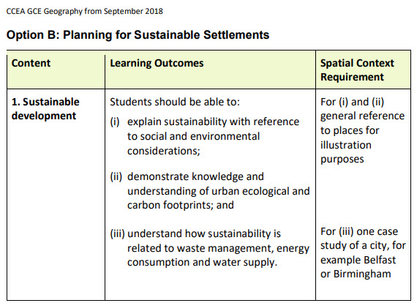
Alignment to specification – A2

Slide 5
History
Originally sustained by Musqueam (mus-kwee-um), Squamish (squaw-mish) and Tsleil-Waututh (tslay-wa-tooth)
People evicted in mid-1800s to ~1913 but have adapted and survived
Trading post (1827), Canadian Pacific rail, sea-trade (Panama canal)
Named after Royal Navy captain George Vancouver who sailed past in 1792
Original trade in gold & timber
New Westminster main base for Europeans in late 1850s
Immigration by East Asians after WW 2
Anti-Asian riots common (e.g., Komagata Maru ship, 1914, with more than 300 Indians, was not allowed to disembark its passengers and was forced to return to India).

Slide 6
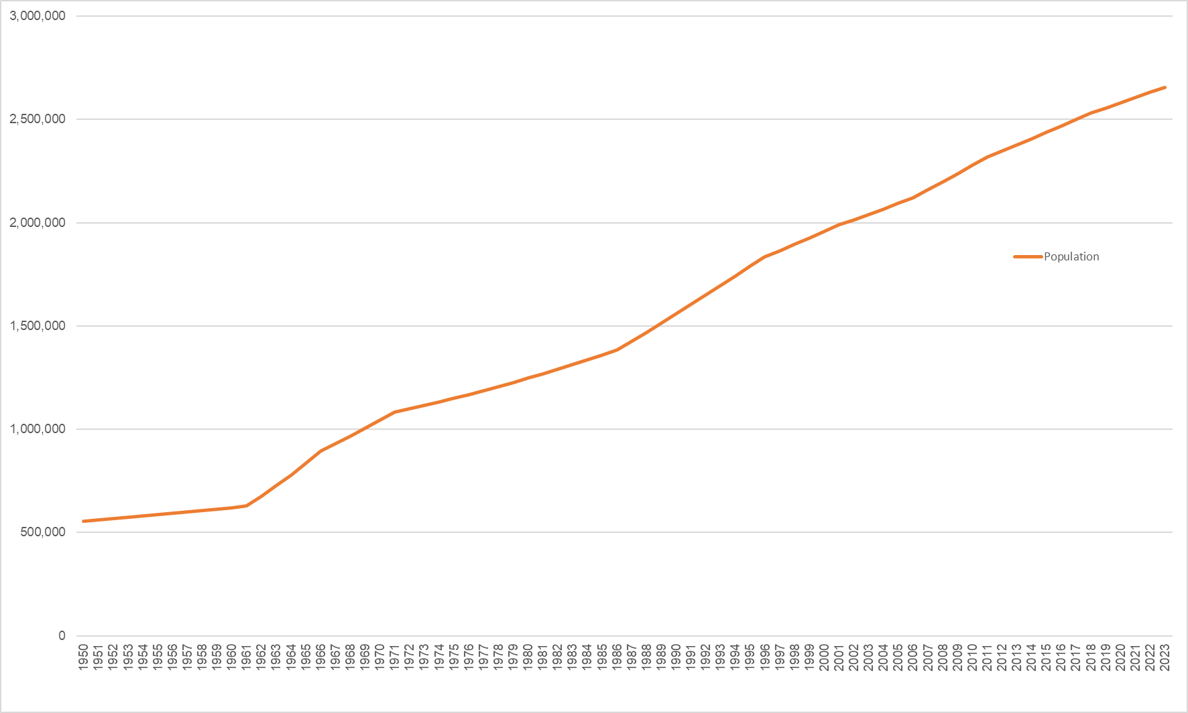
1963
Growth rate 7.4%
1987
Growth rate 3.0%
2022
Growth rate 1.0%
Canada Metro Area Population, Vancouver, 1950-2023
Vancouver, Canada Metro Area Population 1950-2023 | MacroTrends

Slide 7
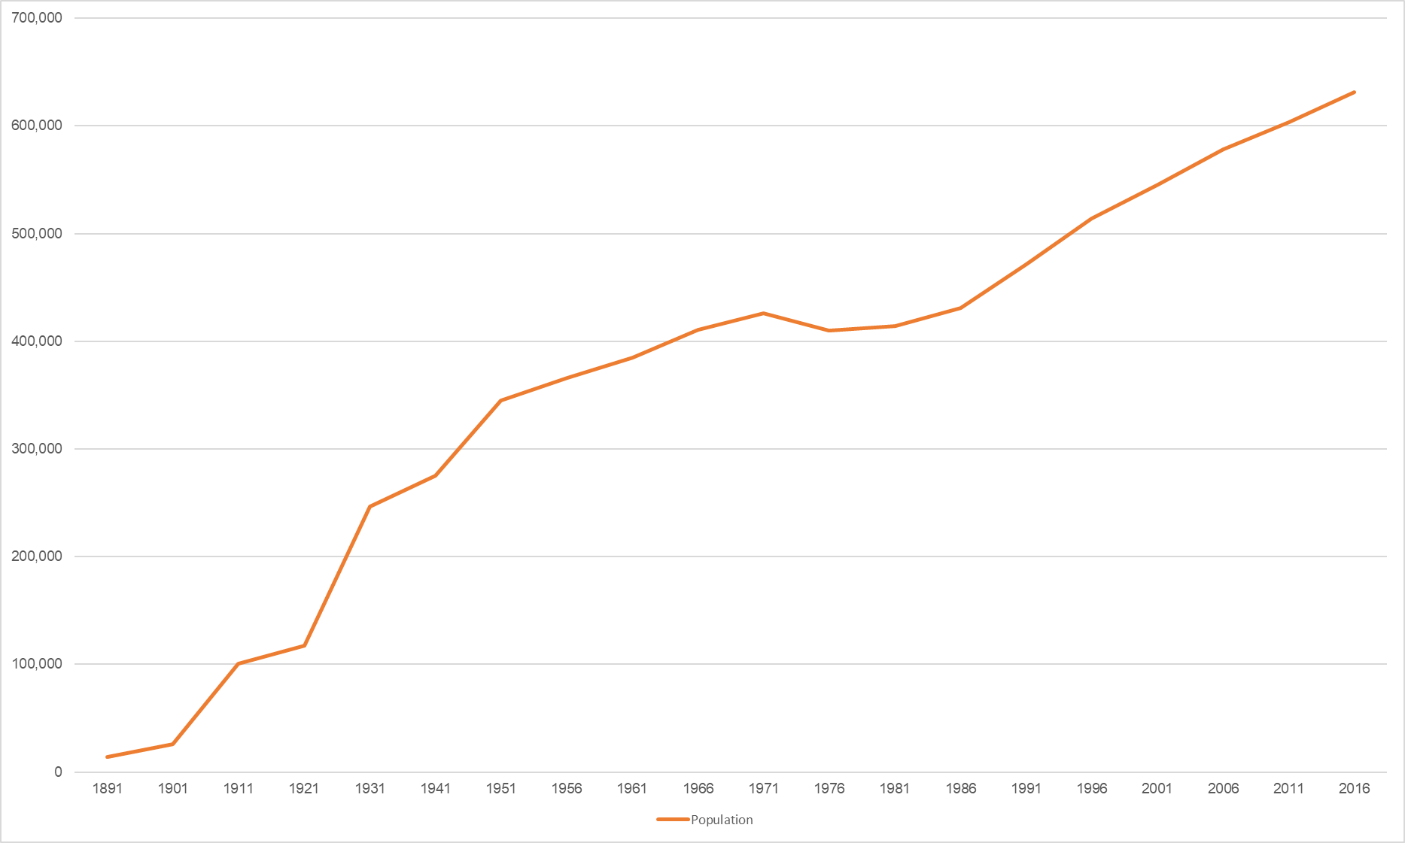
1963
Growth rate 7.4%
1987
Growth rate 3.0%
2022
Growth rate 1.0%
1911
Growth rate 284.2%
1991
Growth rate 9.4%
Vancouver Population Growth, Census, 1891-2016
Vancouver Population 2021/2022 – Canada Population

Slide 8
Population composition
Canada 2nd largest country by area (Russia 1st)
Across the country, population density is 10.2 people / square mile
10th least densely populated country in the world (Greenland 1st)
Vancouver most densely populated city in Canada (14,162 per square mile) followed by Toronto (11,225 per square mile)
1970s and 1980s saw significant problems (OPEC oil shocks, deepening national debt, increasing unemployment, declines in productivity and per capita GDP growth, housing bubble burst = 40% deflation in house prices)
Canada social housing programme abandoned.

Slide 9
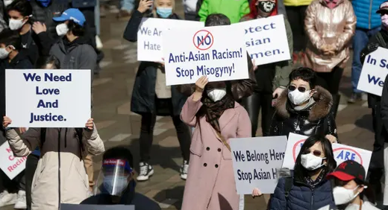
Population composition
Strong courting of Asian Pacific Rim investment led to investment from Hong Kong, China, Taiwan
Business Immigration Programme (BIP) attracted High Net Worth Individuals (HNWIs – Ley 2017)
Foreign national residency offered in exchange for $800,000 loan
European Canadian = 46.2% of population
aka “city of neighbourhoods” (post-modern city?)
717% increase (12-98) in Anti-Asian hate crime
incidents (2019–2020 Covid)
Group | Population | % of total population (631,486)
Chinese | 167,180 | 26%
South Asian | 37,130 | 6%
Filipino | 36,460 | 6%
Southeast Asian | 17,120 | 3%
Multiple visible minorities | 11,070 | 2%
Latin American | 10,935 | 2%
Japanese | 10,315 | 2%
Korean | 9,360 | 1%
West Asian | 8,630 | 1%
Black | 6,345 | 1%
Arab | 2,965 | 0%
Other visible minority | 1,500 | 0%
TOTAL | 319,010 | 51%

Slide 10
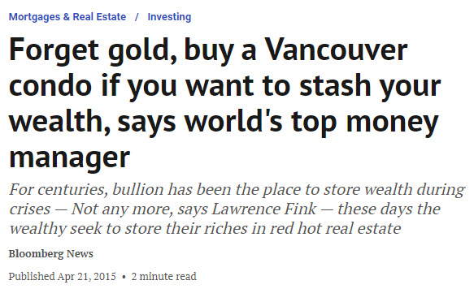
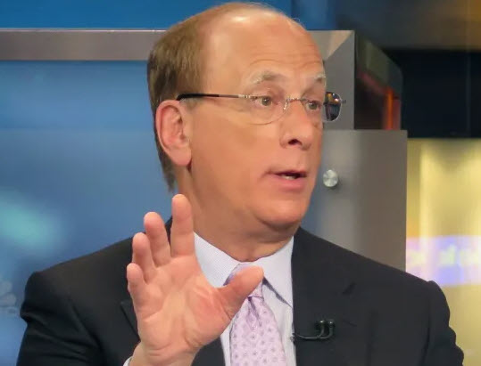

Slide 11
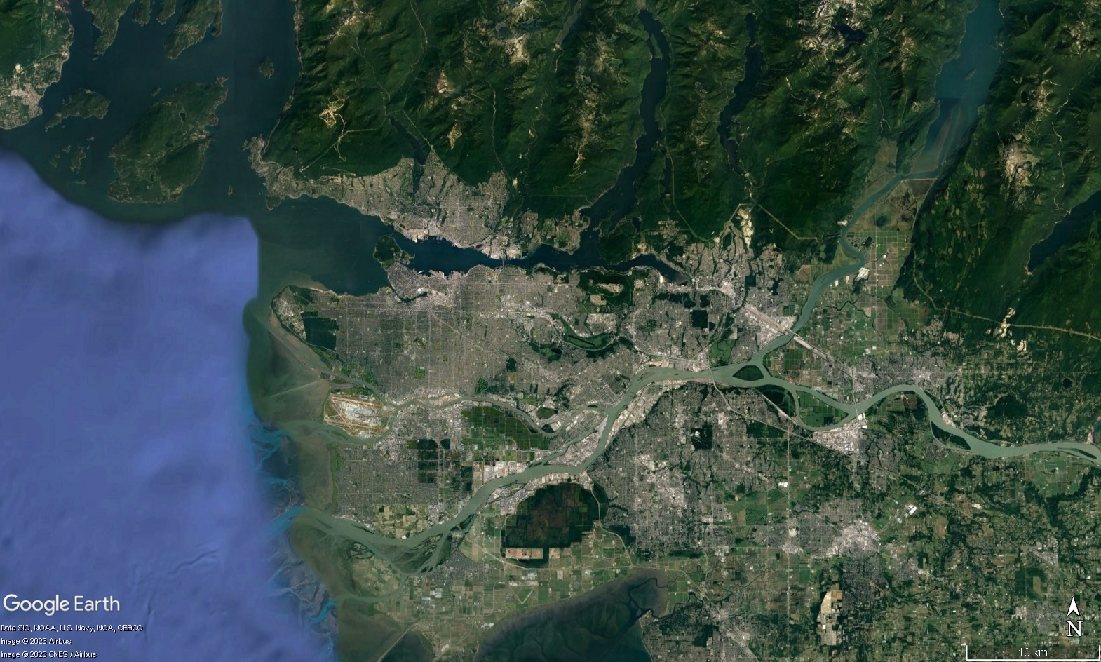
North Shore Mountains
Burrard inlet
Burns
Bog
Fraser river
Strait of Georgia

Slide 12
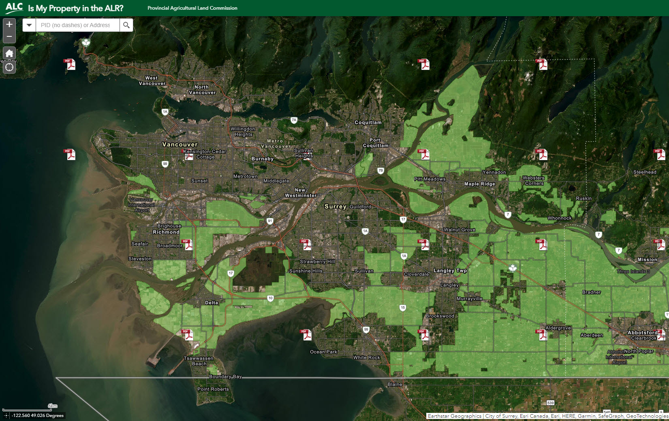
Agricultural Land Reserve
Agricultural Land Reserve acts like a green belt but as of 31 Dec 2021 there is increased flexibility for residential development for families and businesses

Slide 13
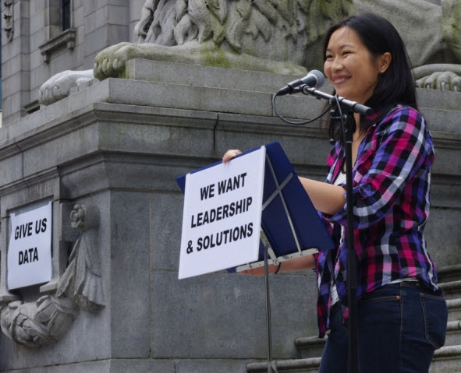
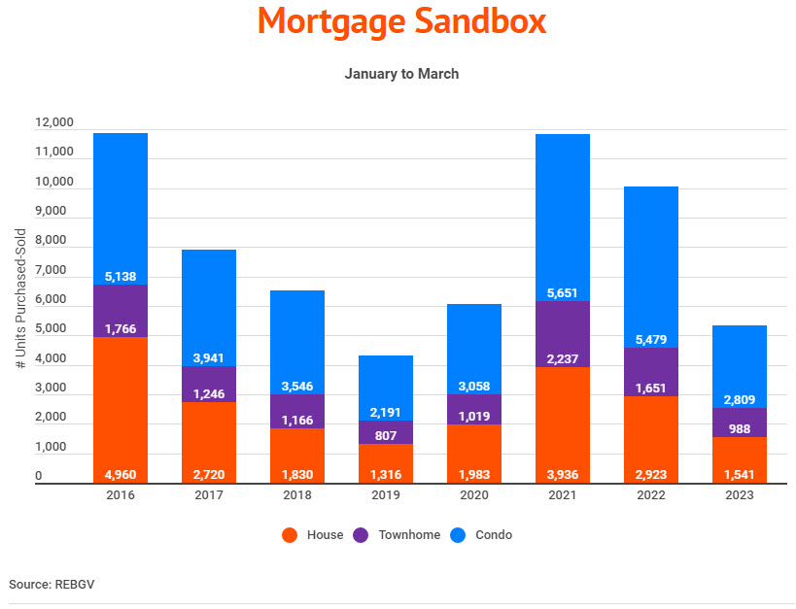
Sustainable Housing
Foreign investment & constrained land = problem!
Rapid rise in house prices (again) – “irrational market”
#DontHave1Million - Eveline Xia (2015)
Pandemic increased prices
Rise in interest rates impacting buyers
Lower prices means fewer sellers
Vancouver has low numbers of families
Displaced population to Metrotown, Coquitlam,
Port Moody, New West, Lougheed and Surrey
Central (suburbanisation)

Slide 14
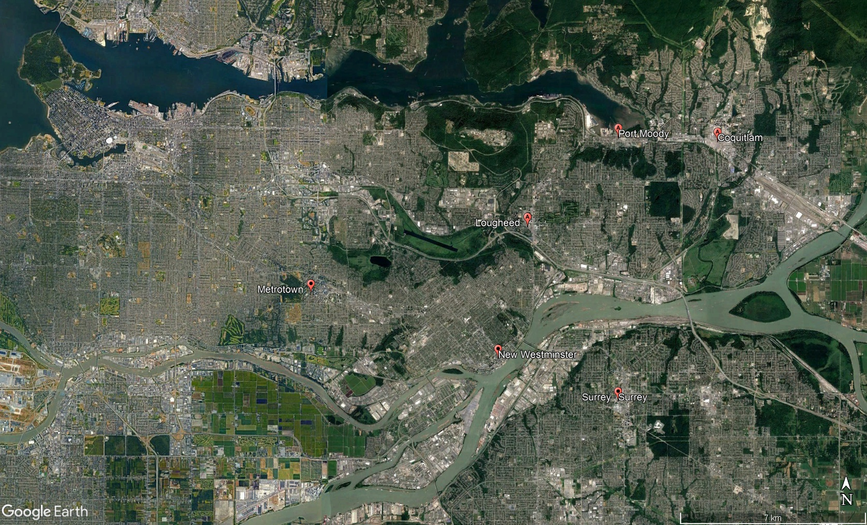
$7 mn development 2022 – mixed use ‘passiv’ housing

Slide 15
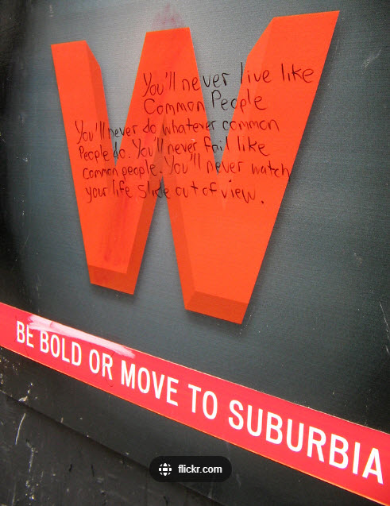
Sustainable Housing
Layout required greater density & building height (250 residential towers, ‘60s to ’15) – extreme stacking from Hong Kong (Newman & ‘defensible space’)
Urban infill (urban resurgence) while protecting views (view-based urbanism)
Gentrification – Woodward’s building – subsidised housing & lavish condos (sold out in 1 month) – 200 affordable homes (inclusionary zoning – 1988 – 20% affordable housing in rezoned neighbourhoods)
Downtown core revitalized, school enrolment up 30%,
increase in active travel
Housing Vancouver (2018-2027) is strategy to address Vancouver’s housing crisis, targeting 72,000 new homes over 10 years
Social & Supportive housing, purpose-built rental, condos, laneway houses (legal 2009), coach houses, townhouses
“Missing Middle” housing (multiplexes) with up to 6 units per lot!

Slide 16
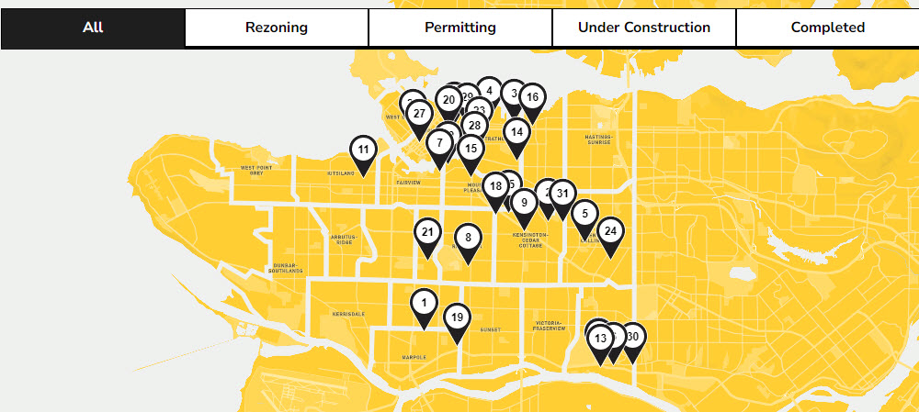
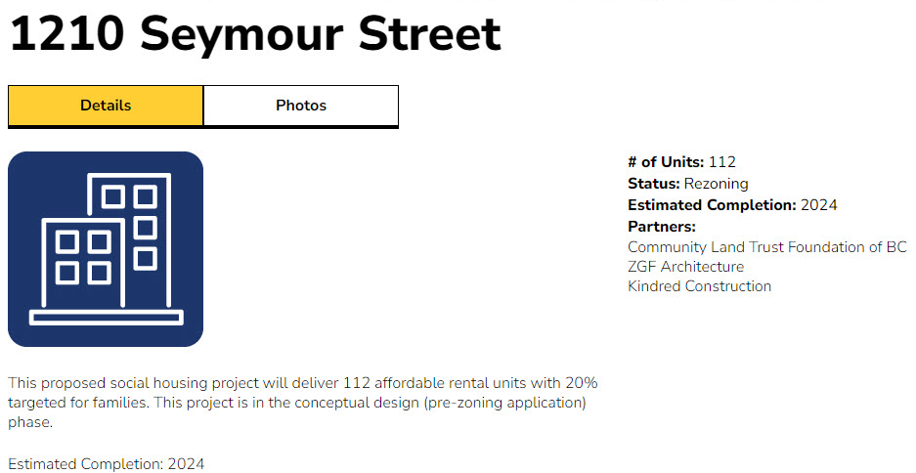
Sustainable Housing
Foreign Buyers Tax @ 20% (2016)
Empty homes tax @ 1% tax of value
Vancouver Affordable Housing Agency (VAHA)
“If we are going to put British Columbians first, and that is what we are intending to do, we need to make sure we do everything we can to try and keep housing affordable,” Christy Clark, BC premier

Slide 17
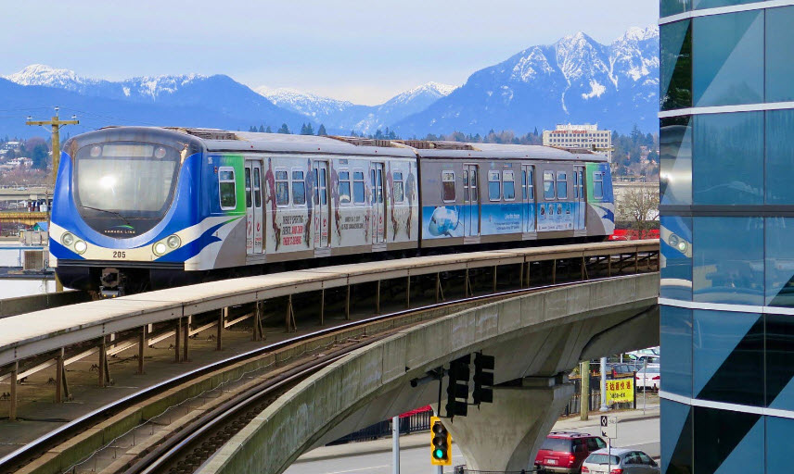
Sustainable Transport
Vancouver’s density is largely responsible to policies on transport
1967 – dying CBD, overcrowded, high car ownership, inner city decline
Le Corbusier and Moses approach of ‘blank slate’ and start again
Protests to freeway that would destroy Chinatown
Electric streetcars ~1890 saw neighbourhoods spring up around stops
1950s end of the line (!) due to high costs
“Rails-to-Rubbers” – adoption of bus network.
Also SkyTrain (rapid transit), SeaBus and West Coast Express (commuter rail)
Active Travel
Car pooling (Modo the Car Co-op)
Cars slowed down (signals, crosswalks, traffic lights) – car parks transformed!

Slide 18
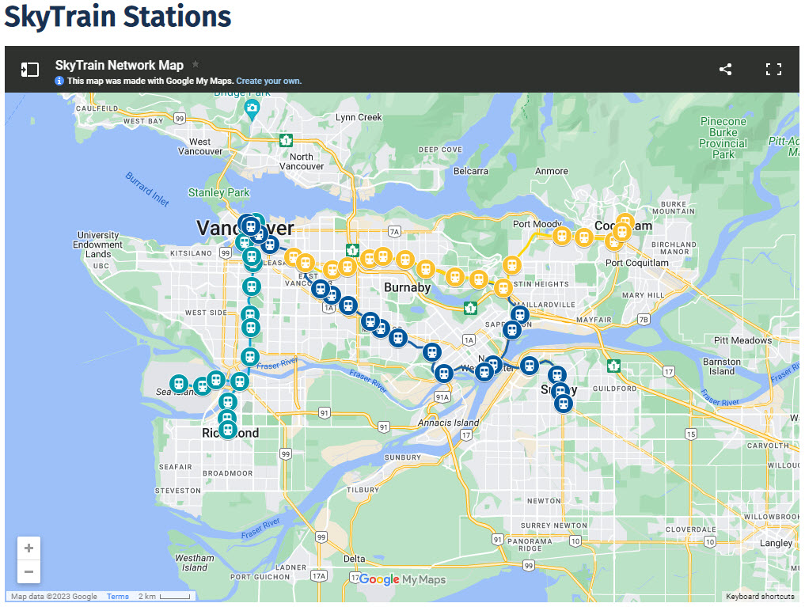
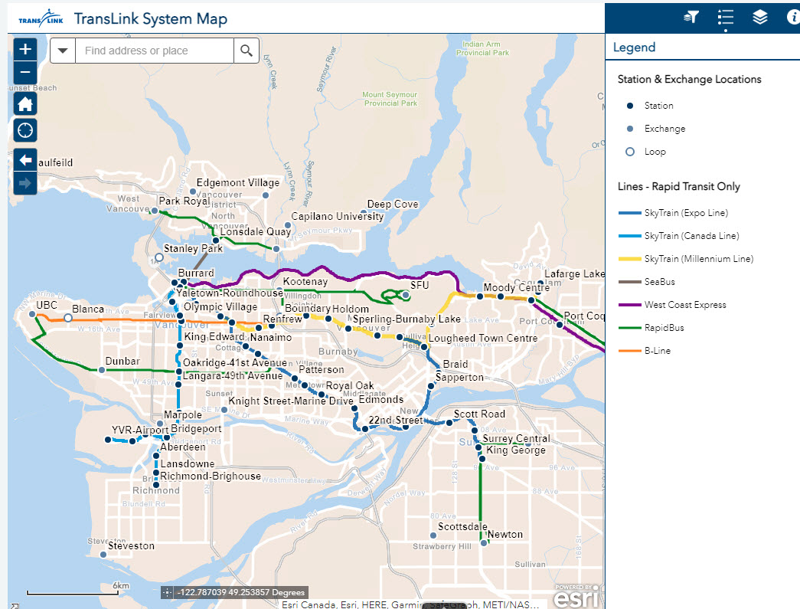
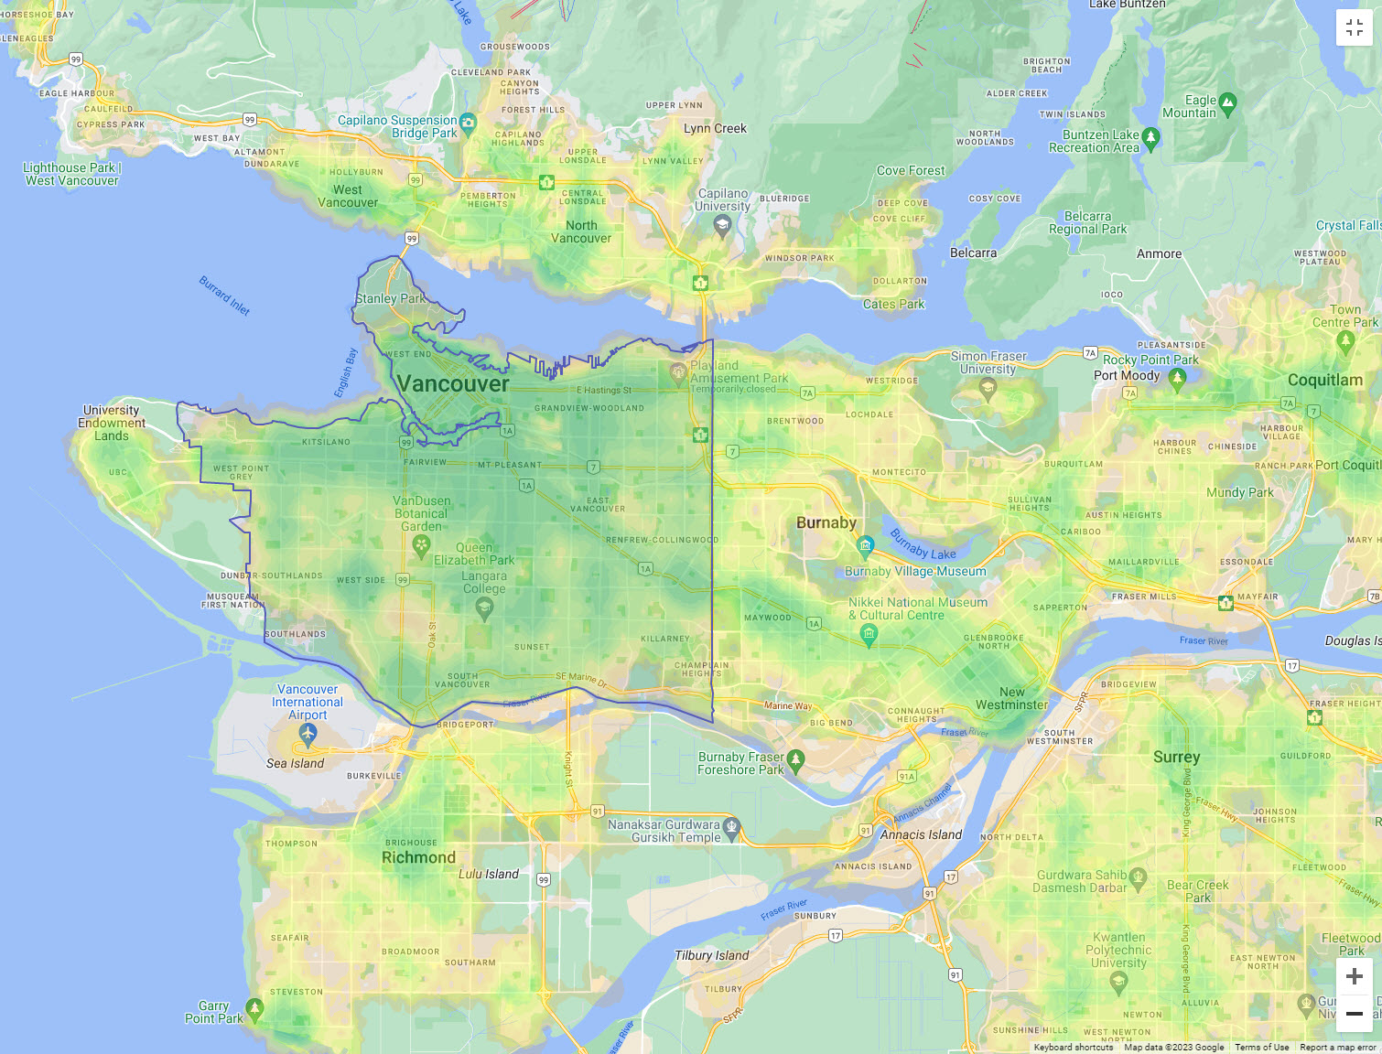
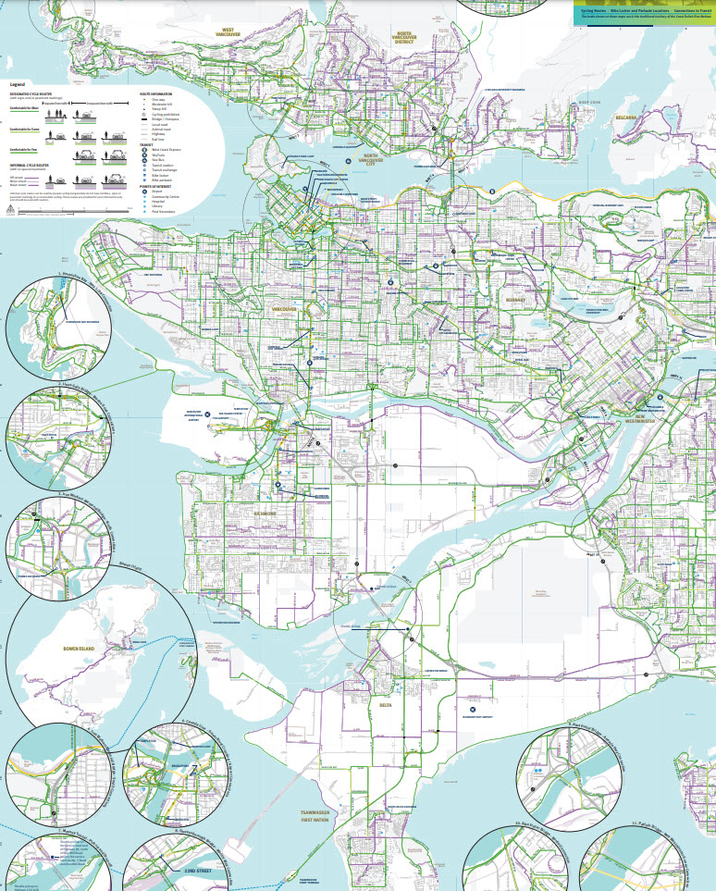
Vancouver BC - Walk Score

Slide 19
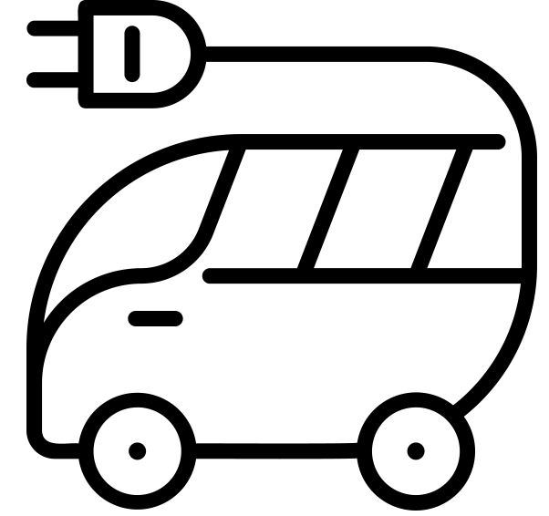
Sustainable Transport
“Sustainable Commuting”
Rebates on transit passes
Incentives and reserved parking for shared transport
Incentives for active travel
Guaranteed Ride Home program for emergencies
Funded through paid parking at market rates for employees at City Hall lots
2030 targets
2/3 of trips in Vancouver by active travel / transit
50% of kilometres driven on Vancouver's roads will be by zero emission vehicles
2040 vision
Vehicle Kilometre Travelled (VKT) decrease (e.g., bulk transit up).
Greater provision of EV charging
Battery-operated and emission-free plane from Fraser Island
Similar in many ways to 15 minute cities

Slide 20
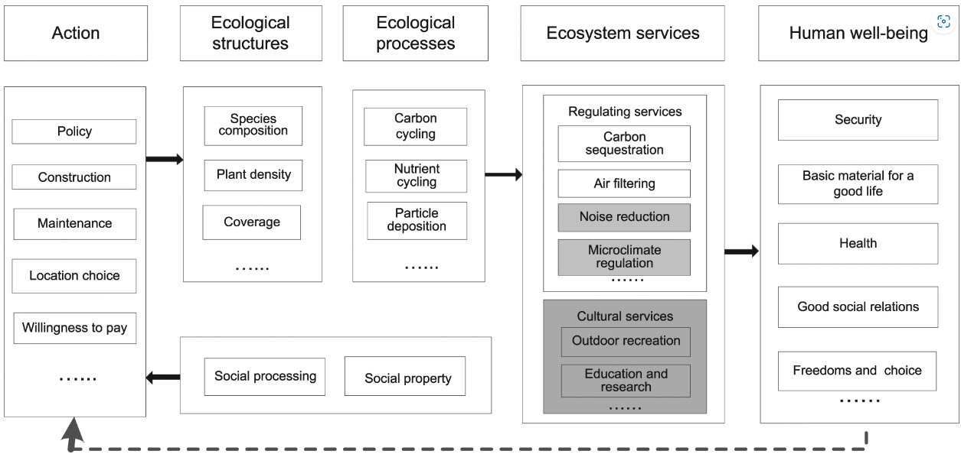
Greenspaces
Over 200 parks and greenspaces + community gardens, street trees
Saltmarshes, bee-friendly zones, rooftop gardens, repurposed railway lines
Gil Penalosa “cities need green in sizes S, M, L and XL” (Montgomery, Happy City, p. 123)
2017 – 93% of city within 400 m of a park!
Vancouver’s first city plan (1928 Bartholomew Plan) recommended ~1 acre per 100 people & within walking distance.
Greenspaces also help with urban heat islands, water storage, carbon storage, pollution, biodiversity, physical & mental health, house prices, community cohesion, views etc!
Chang et al., (2017)
Assessing the ecosystem services provided by urban green spaces along urban center-edge gradients, Nature Scientific Reports, 7, p. 11226

Slide 21
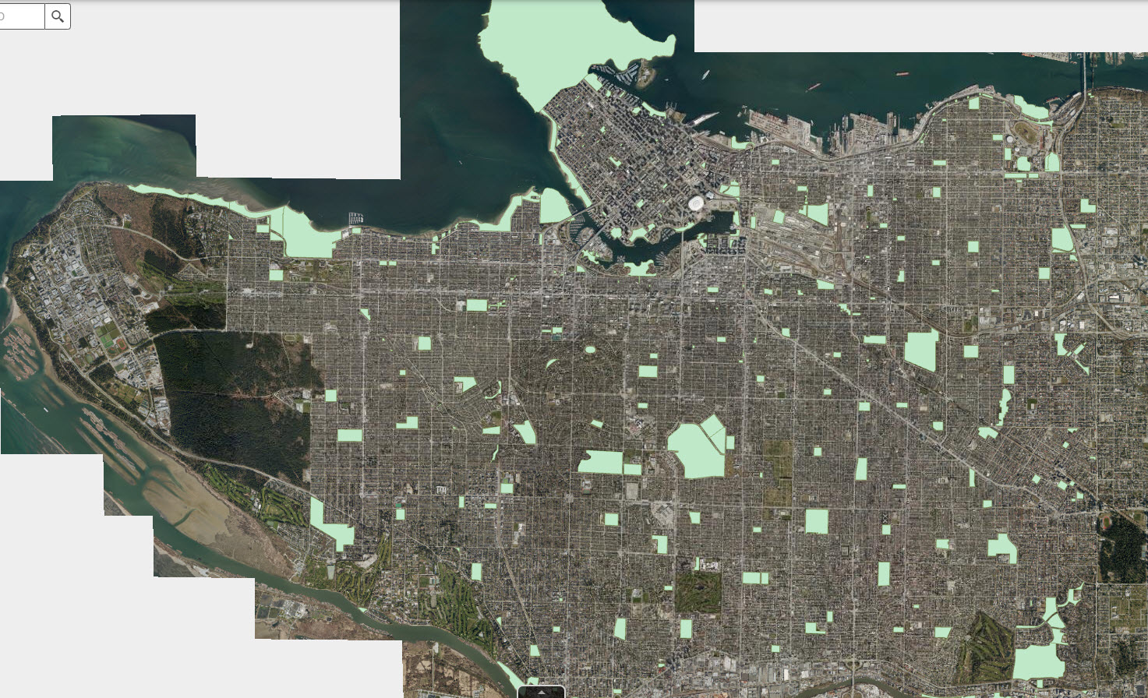
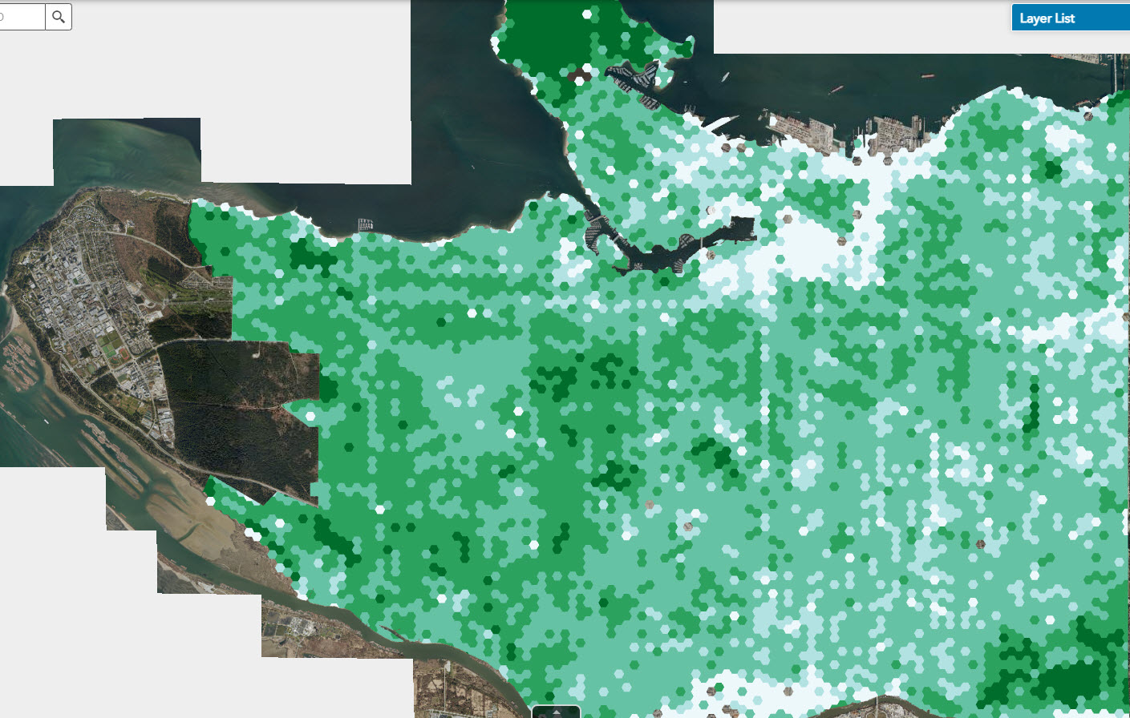
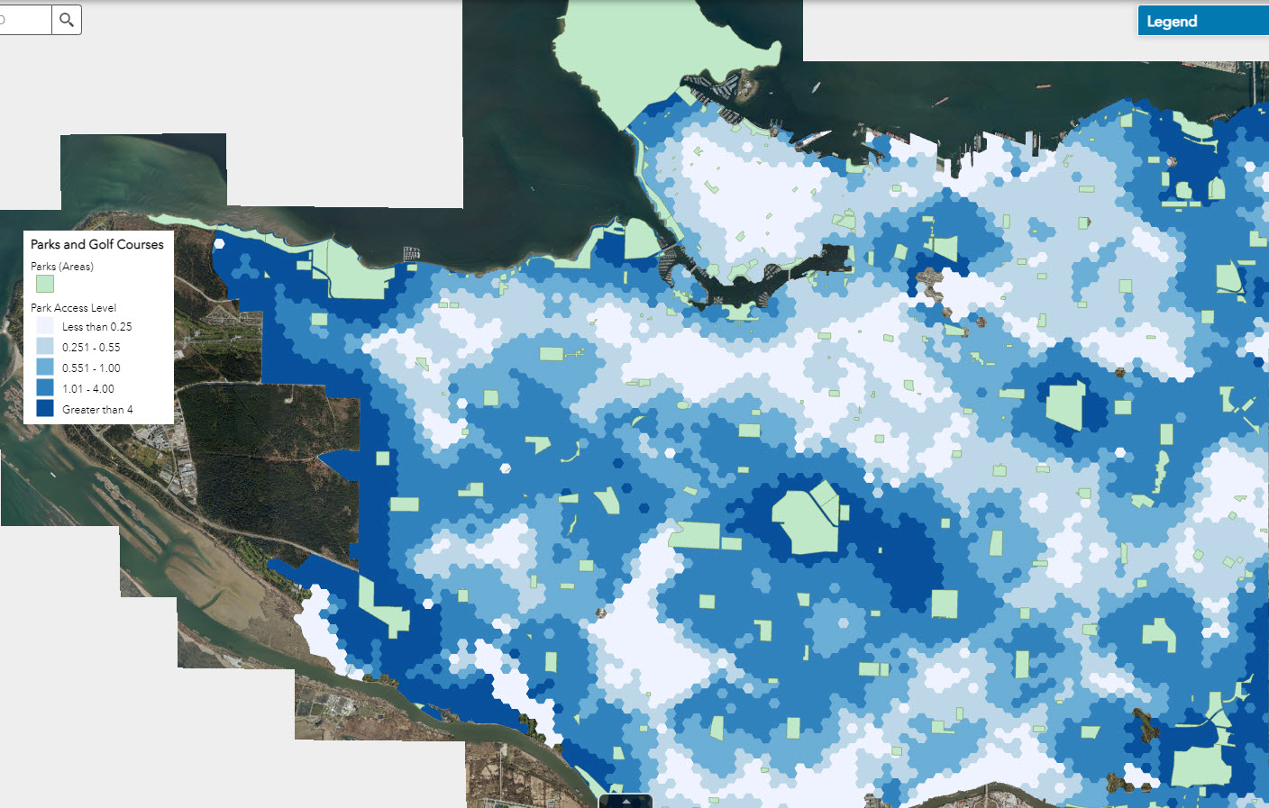
Parks
Tree canopy
Park accessibility

Slide 22
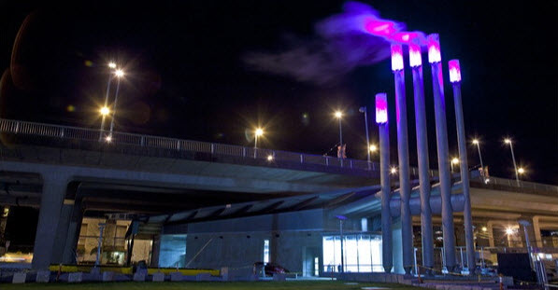
Sustainable Energy
Retrofits – reduce GHG and energy demand – almost ‘passiv haus’ standards
“Operation Co$t Cutter” partnership approach to guide retrofits – education, energy assessments, ROI, choosing suppliers, incentives
In year 1, 18 buildings (>800 units) reduced 650 tCO₂e and saved 28 million litres of water
Energy system model – demand and supply mapping and monitoring
Hydroelectric plant + mean >95% of city’s electricity is from renewables
District Heating – captures waste heat from burning rubbish – 16,000 homes powered from Waste-To-Energy Facility – reduce 120,000 t CO₂ pa. Capture waste heat
2010 Olympic Village at False Creek – waste heat (showers, toilets..) extracted and transferred to clean water, radiant heat and hot water – GHG emissions reduced >75%
New homes – zero emissions (ZEB)
Solar PV also commonplace

Slide 23
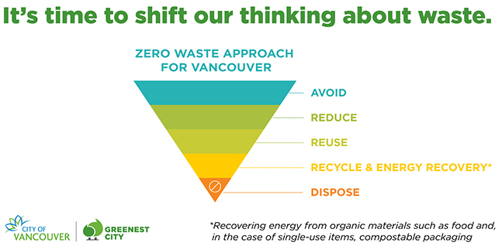
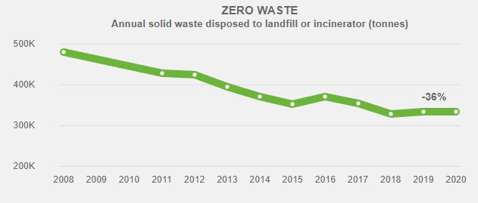
Sustainable Waste
“100-mile diet” (Smith and MacKinnon, 2005)
Zero Waste 2040 Plan
Systems approach and “circular economy”
Community networks
Single-use items (bags banned, reusable cups, straws scrapped!)
Education, Demonstration (Zero Waste Demonstration Site), Employment
58% residential waste diversion and 16% decrease in water consumption
Vancouver waste hierarchy
Zero Waste 2040 | City of Vancouver

Slide 24
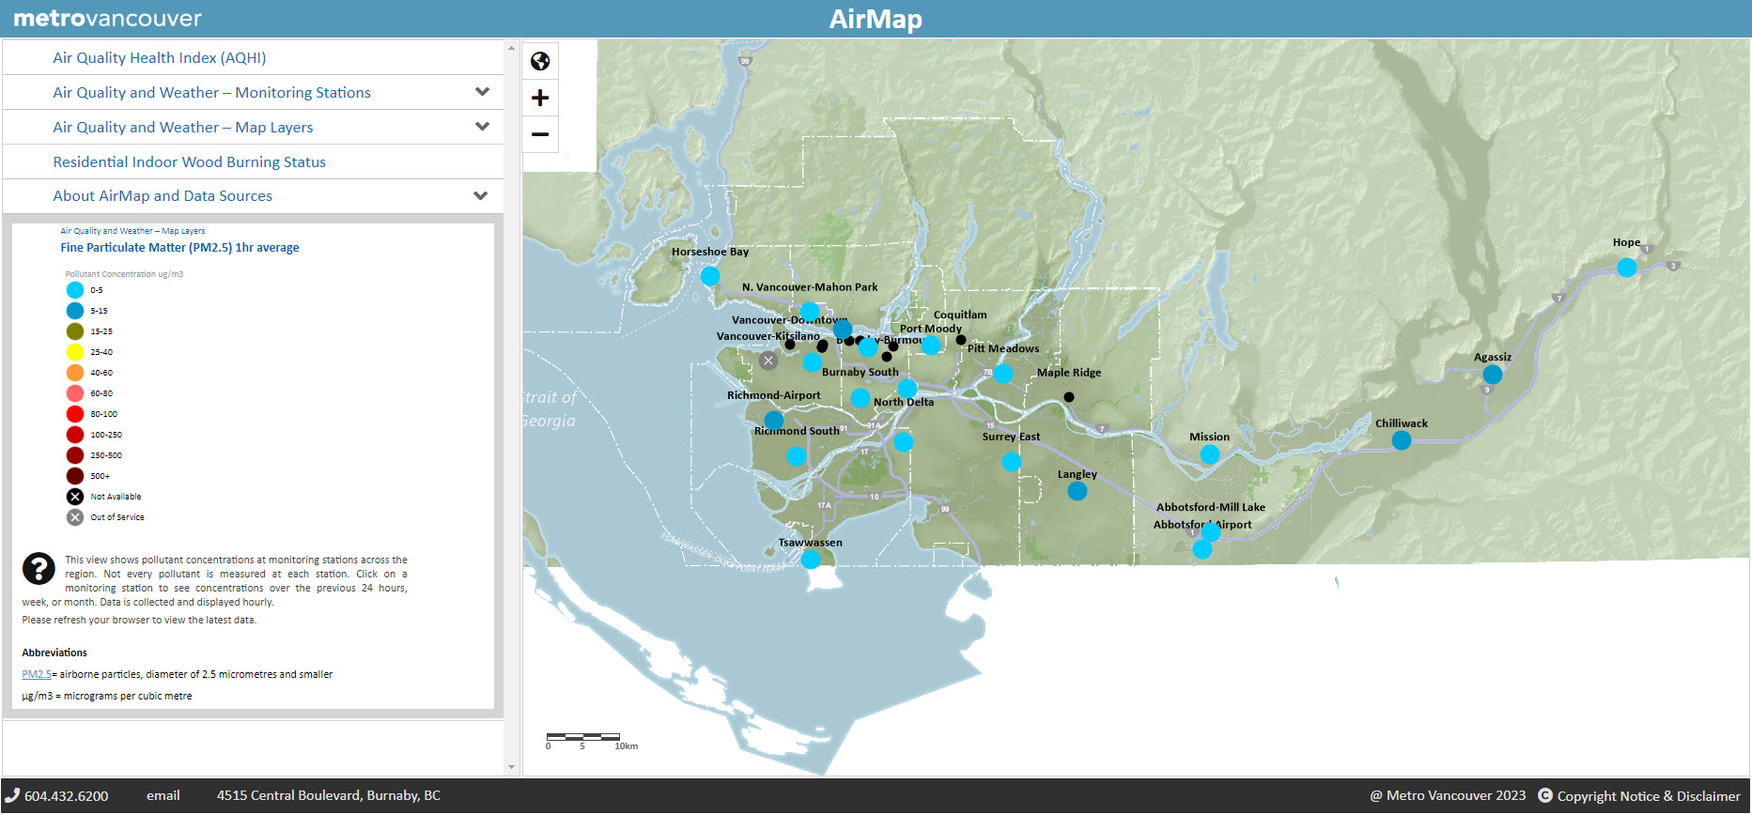
Air Quality
Changed transport (pedestrian zones, banning diesel vehicles..)
Clean Air Plan (2050)
By 2030, reduce GHG by 45% from 2010 levels
Meet outdoor levels meet air quality standards
Improve visual air quality
Transport (EVs, bulk transit), Industry (legal requirements), Buildings (wood stoves, passiv), Agriculture (open-air burning), Collaboration
Air quality reports suggest decreases across main contaminants
Air Monitoring Map

Slide 25
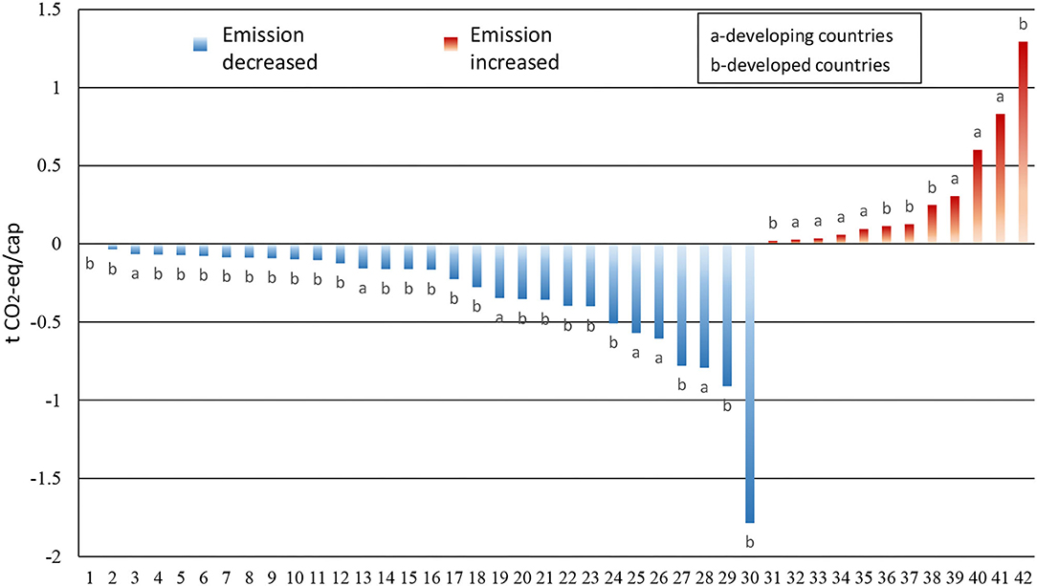
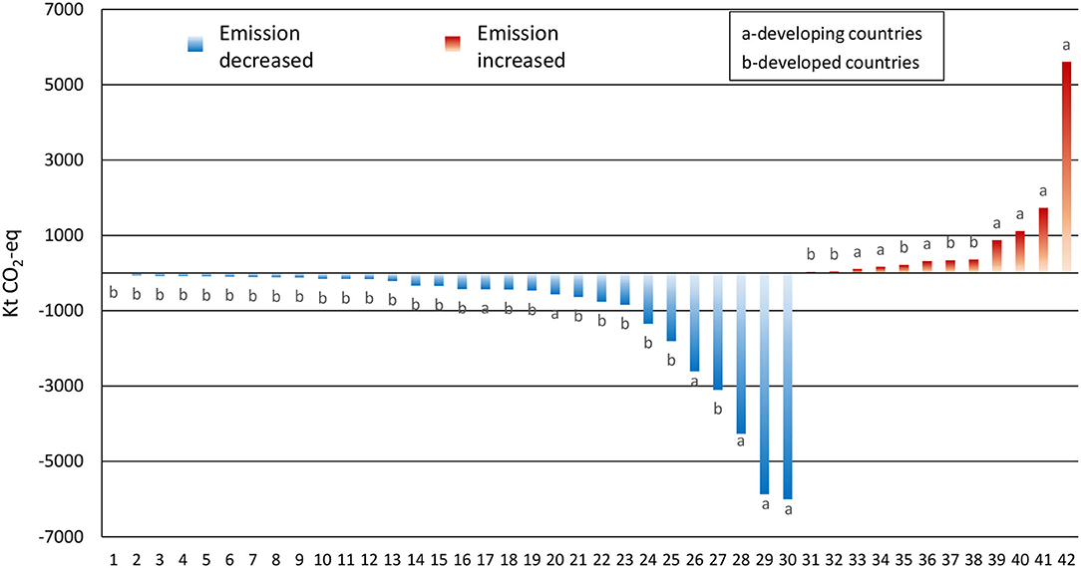
Sustainable Waste
Wei et al (2021) Keeping Track of Greenhouse Gas Emission Reduction Progress and Targets in 167 Cities Worldwide, Frontiers in Sustainable Cities, 3
Seattle
Bangkok

Slide 26
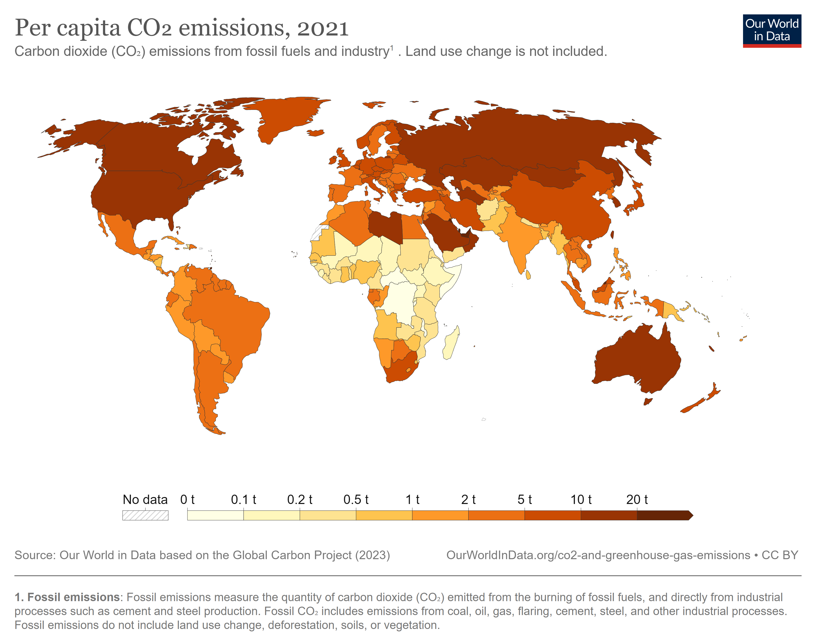
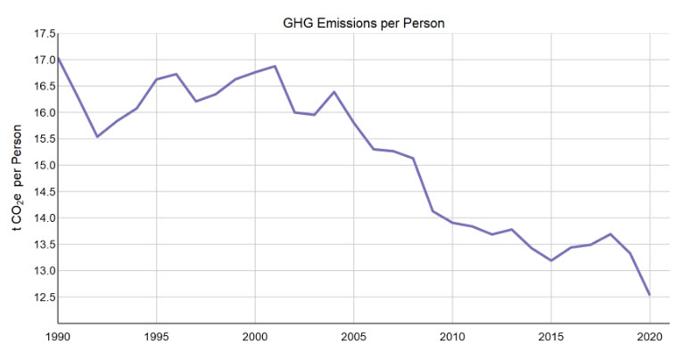
Sustainable Waste
Decrease in 2020
due to COVID-19
Canada 15th – 14.3 CO₂ emissions per capita
Qatar 1st – 35.6

Slide 27
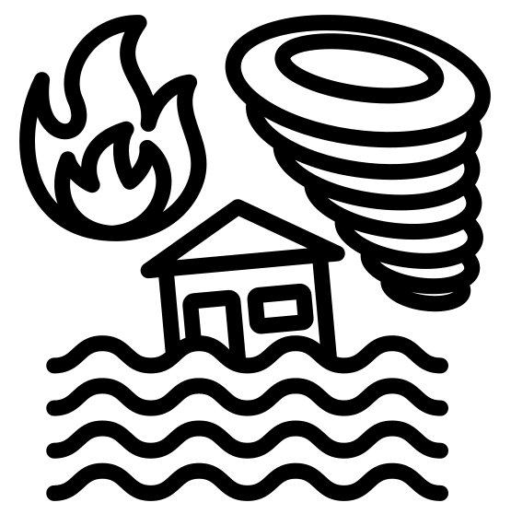
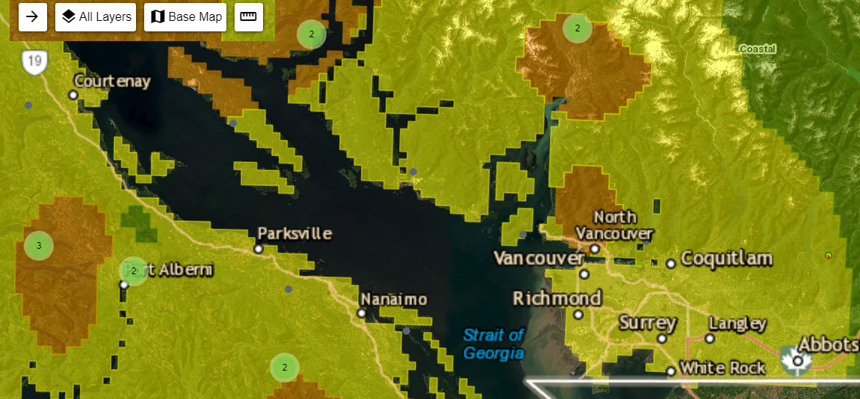
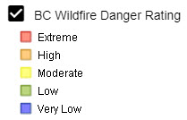
‘Natural’ threats
Earthquakes – tectonic plates; city plans; map viewer video demo
Flooding – StoryMap; Severe floods in Nov ’21 but frequent occurrence
Sea level rise - city plans; False Creek and Fraser River areas at risk; Projection maps and video demo
Wildfires – Interactive map

Slide 28
Sustainability in Vancouver?
Climate Action Plans – 6 “Big Moves” (land use, movement, energy, restoration)
Economist Intelligence Unit (EIU) Global Liveability Index 2022 – Vancouver 5th, Calgary 3rd (with Zurich)
WWF - first winner of Earth Hour City Challenge 2013
Arcadis Sustainable Cities Index 2022 (17th out of 100 – Oslo 1st; London 5th)
Signatory of “C40” scheme, network of ~100 mayors against climate crisis.
Greenpeace ‘born’ in Kitsilano suburb in 1971
Regularly tops lists of sustainable settlements
Problems with sea and air travel
Climate change likely to be a significant challenge
Housing also a significant problem (SDG 11 Social Target)
Canada has environmental demons to deal with (e.g., Alberta tar sands and destruction of old-growth forests like those on Vancouver Island)

Slide 29
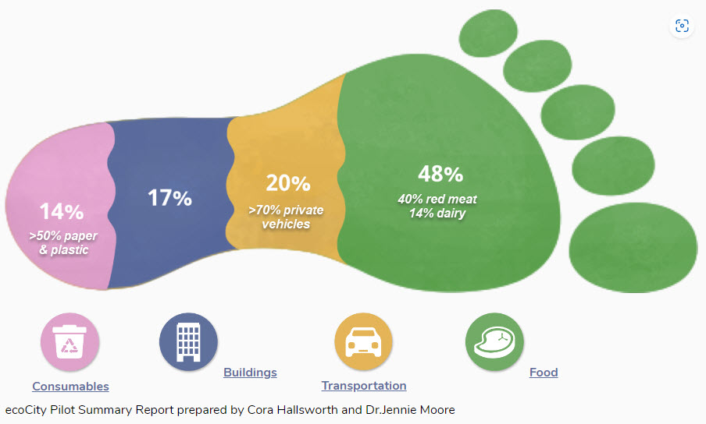
Sustainability in Vancouver?
Moore et al. (2013) - Metro Vancouver's ecological footprint in 2006 as equivalent to 10,054,400 global hectares.
Moore et al. (2013) – 2006 - 4.75 gha/ca.
Almost double the world average biocapacity demand (2.7 gha/ca)
Almost three times the global per capita biocapacity supply (1.8 gha/ca).
Ecocity report (2018) – 3.4 gha / person
SFU – 2.9 gha / person

Slide 30
Online map viewers - Vancouver
https://maps-vancouver.com/
http://www.metrovancouver.org/metro2040
Statistics Canada: Canada's national statistical agency (statcan.gc.ca) – video demo
Canada Index of Multiple Deprivation (CIMD) – video demo in ArcGIS Online
AirMap (metrovancouver.org)
https://maps.vancouver.ca/vanmap-viewer/ (Brilliant!)

Slide 31
Excellent websites
Green Vancouver | City of Vancouver
Vancouver - C40 Cities
Happy Cities | Stories
Home | City of Vancouver
Vancouver district energy | WWF (panda.org) (+ other WWF pages)
LidarBC - Open LiDAR Data Portal (arcgis.com)
Home - Global Footprint Network
Global Gridded Model of Carbon Footprints (citycarbonfootprints.info)
Focus on Geography Series (statcan.gc.ca)
Recording of talk available

Slide 32
Dr Paul McKenzie sjp.mckenzie@ulster.ac.uk 028 7012 4628

