Slide 1
The Dissertation Proposal
School of Geography and Environmental Sciences
Ulster University
Rory Quinn
Dissertation Co-ordinator

Slide 2
Introductory sessions - Year 2
Week 1
Session 1: The dissertation process (Dr Rory Quinn)
Session 2: Research ethics and H&S (Dr Sara McDowell)
Session 3: Library session RefWorks and lit searches (UU Library Staff)
Monday: 11.15-13.15, IT Suite Library Surnames: Andrich to McAteer
Week 2
Session 4: The research proposal (Dr Rory Quinn)
Session 5: Library session RefWorks and lit searches (UU Library Staff)
Monday: 11.15-13.15, IT Suite Library Surnames: McCann to Wright

Slide 3
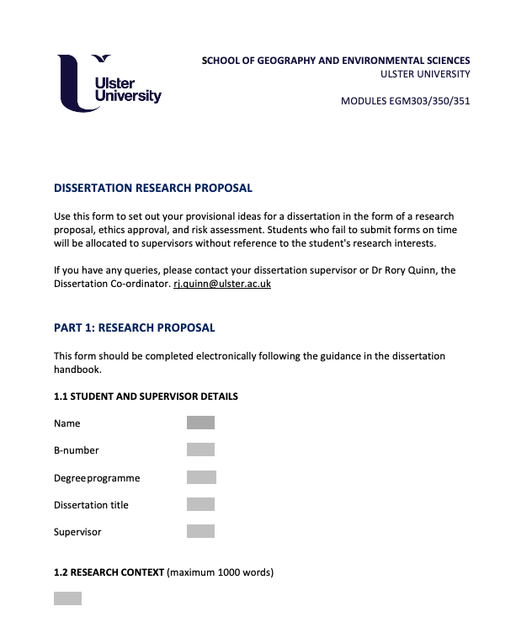
Research proposal
Submission
You must submit the research proposal using the MS Word template (week 6).
Supervisors will mark and provide feedback in discussion in Meeting 1 (week 9).
The research proposal contributes 25% of the mark for field course module EGM303/350/351.

Slide 4
Why do scientists write research proposals?
What information do research proposals contain?
What is the desired outcome of a research proposal?

Slide 7
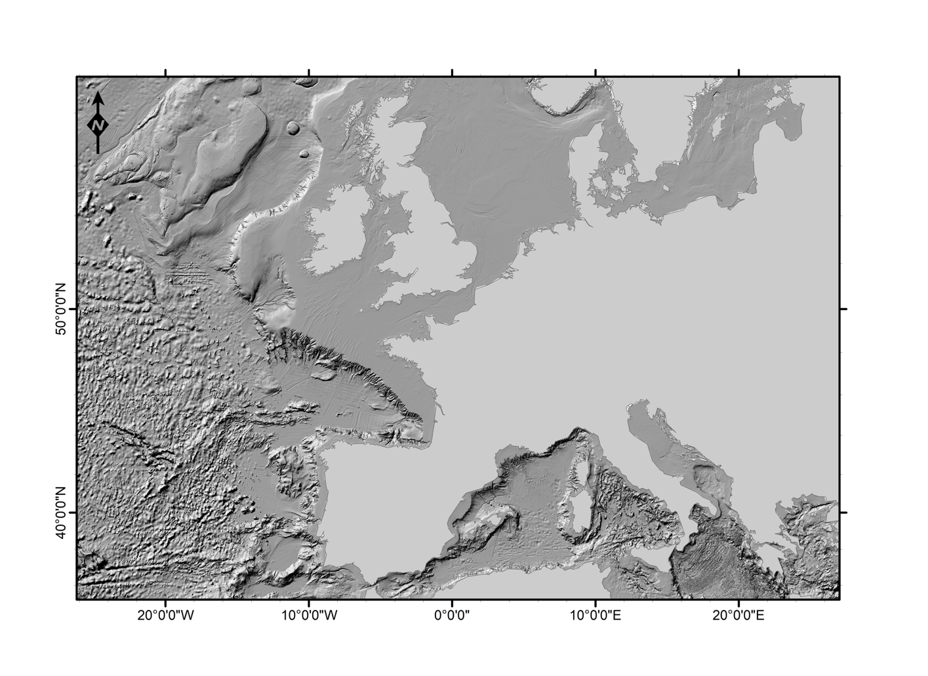
National Museum of Denmark
4 proposals submitted – two funded,
2.5M euros
David Gregory
Henning Matthiessen
Gert Norman Andersen
NI, England, Scotland, Wales
1 proposal funded, £2.3 Million
Museums, Universities – National
Collection

Slide 8
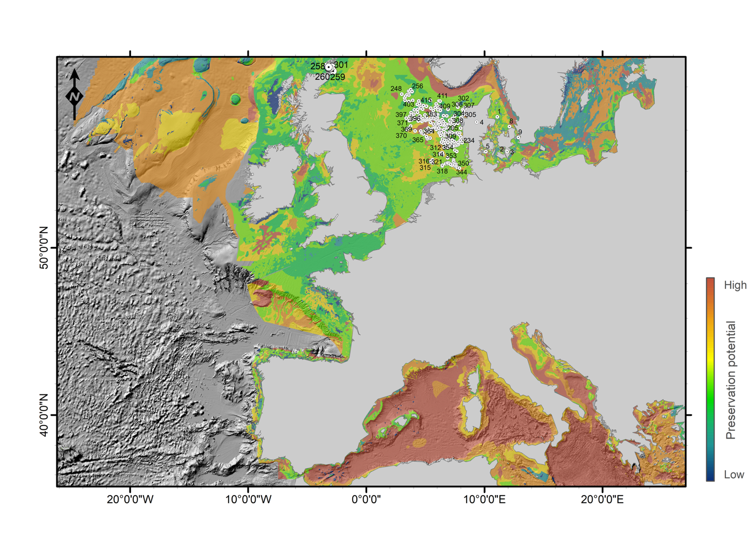
Sustainable preservation of Underwater Cultural Heritage

Slide 9
Your research proposal
Guidelines
Once your dissertation topic is agreed, you must write a dissertation research proposal, informed by the scientific literature.
The research proposal contains:
section on the research context (a minimum of five references should be cited, word limit of 1000 words),
a clear statement of aims and objectives (and hypotheses if appropriate),
an outline of the methodology you propose to use in the study,
a timeframe for the study in the form of a gantt chart,
a completed risk assessment, and
an ethics approval form.
Use your own figures and tables in the research proposal to get across your
points - especially effective when the word limit is tight.

Slide 11
1. The Research Question
Asking the right research question is the most important part of the dissertation.
The aim of any research is to answer a research question.
Therefore it is crucial to work out a clear research question at an early stage.
The best dissertations are those which ask good questions that are clearly answered.
Don’t try to do too much, or set a research question that you can’t answer within the scope of the project.

Slide 12
Your research question will guide and inform:
Your literature search
You in deciding what data you need to collect to answer your question
The methods you will need to use
Your data analysis
The writing up of your data
The conclusions you draw
i.e. the answers to your research question, and stop you from going off in unnecessary directions such as collecting data you don’t need, or doing analysis that you won’t use.

Slide 13
When deciding what data to collect and what analysis to conduct, you should constantly be asking:
‘How does this relate back to my research question(s) that I have to answer’?
If it doesn’t relate back to your research question, you need to either adjust your methods or analysis, or adapt your research question.

Slide 14
2. Hypothesis
Some research projects are built around a specific 'hypothesis'. A hypothesis is an idea or explanation that can be framed as a statement to be tested in the research.
The statement is likely to be developed from an expectation based on theory or on previous observation, but which needs to be formally tested, using objective and unbiased methods, to find out whether the statement is true or not.
You can think of a hypothesis as being a more specific form of research question.
Some dissertation projects lend themselves to hypothesis-testing; others do not.

Slide 15
For example, a researcher interested in investigating the impact of poverty on population health could formulate a research question along the following lines:
'What type of relationship exists between socio-economic circumstances and life expectancy in my study area?'
Alternatively, the research could be based on testing a specific hypothesis, e.g.
'Adverse socio-economic circumstances are associated with poorer life expectancy in my study area'
A research question is often more general and flexible than a hypothesis.

Slide 16
3. Aims and objectives
It is often useful to consider your research questions in terms of aim(s) and objectives.
Aims are broad statements of desired outcomes, or the general intentions of the research, and emphasize what is to be accomplished (not how it is to be accomplished).
Once aims have been established, the next task is to formulate the objectives. Generally, a project should have one or two aims, while it may include a number of objectives consistent with the aim(s).
Objectives are subsidiary to aims. They are the steps you are going to take to answer your research questions or a specific list of tasks needed to accomplish the project aim(s). Objectives emphasize how aims are to be accomplished and should be focused and feasible.
Your aim(s), objectives and hypothesis (if appropriate) should be informed by the scientific literature.

Slide 17
Example: aim and objectives
The aim of this study is to characterize the seabed and sub-surface in Belfast Lough from an abiotic perspective. This aim is met through the following five objectives:
1. To characterize and classify the geomorphology of the seabed in Belfast Lough from multibeam echosounder bathymetry data.
2. To derive a substrate map for Belfast Lough from the integration of multibeam echosounder backscatter data and sediment samples.
3. To identify and characterize submerged archaeological sites with a view to avoidance.
4. To characterize the geological/geophysical structure at the site to inform geotechnical issues associated with seabed and subsurface engineering.
5. To identify sites suitable for development through suitability modelling.

Slide 18
4. Research Context
The research context section of the proposal should summarise the main published work in your research area. It is therefore akin to a mini literature review.
It should contain a minimum of 5 references and be approximately 1,000 words long.
A more evolved version of this section will eventually form a significant portion of the introduction to your dissertation.
The aim of this section of the proposal is to show your reader that you have
read, and have a good understanding of, the main published work in your research area.
This section is in effect a mini literature review and should be guided by your research question or topic and will provide the framework for your further work. Your work on this section should therefore inform the aims, objectives and metrology of your dissertation.

Slide 19
It is very important to note that when reviewing the scientific literature, you should not simply summarize what others have published, but you should critically discuss the literature showing insight and an awareness of differing arguments, theories and approaches.
You should synthesize and analyze the relevant published work, linked at all times to your own research question.
A good research context section is therefore critical of what has been written, identifies areas of controversy, raises questions and identifies areas which need further research.
The Harvard referencing system should be used throughout.
If necessary, consult the UU Faculty of Life and Health Sciences Harvard Referencing Guide.

Slide 20
Here is an example of a research context paragraph which forms part of the introduction to a research paper. This is the written style and level of detail that you should aim for:
A major goal of plant ecology is to explain spatial variation in a species frequency of occurrence. Spatial variation in seed predation may contribute to spatial variation in plant frequency by reducing seed supply sufficiently to limit seedling emergence more at one location than another (Louda 1982, Anderson 1989). Spatial variation in seed predation is well documented (e.g., Janzen 1971, 1975,; Bertness et al. 1987; Smith 1987), but few investigators tested whether differential seed predation resulted in differential seedling
emergence (e.g., Louda 1982, 1983). Since factors such as dense ground cover may suppress seedling emergence regardless of the amount of seed predation (Harper 1977), additional studies are needed to clarify the effect of seed predation on seedling emergence. Therefore, we examined the effects of both seed predation and ground cover (i.e., plant biomass and litter) on seedling emergence of some old-field forbs.
Excerpted from: Reader, R.J. and Beisner, B.E. 1991. Species-dependent effects of seed predation and ground cover on seedling emergence of old-field forbs. Am. Midl. Nat. 126: 279-286.

Slide 22
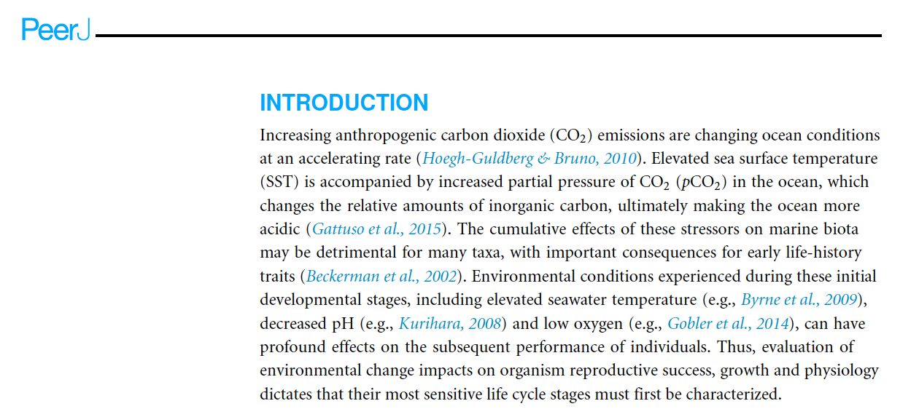
Here is another example of a research context paragraph which forms part of the introduction to Matty Jackson’s research paper:

Slide 23
4. Methodology
Your research proposal methodology should be written in the future tense using the passive voice.
The proposed methodology should be informed by your literature review.
You are unlikely to be the first person to do this type of project, and you can learn a lot from the experiences of other scientists. Your proposed methodology should therefore be informed by the scientific literature.
Your methodology should be of sufficient detail that another student could follow the methods and replicate your results.

Slide 24
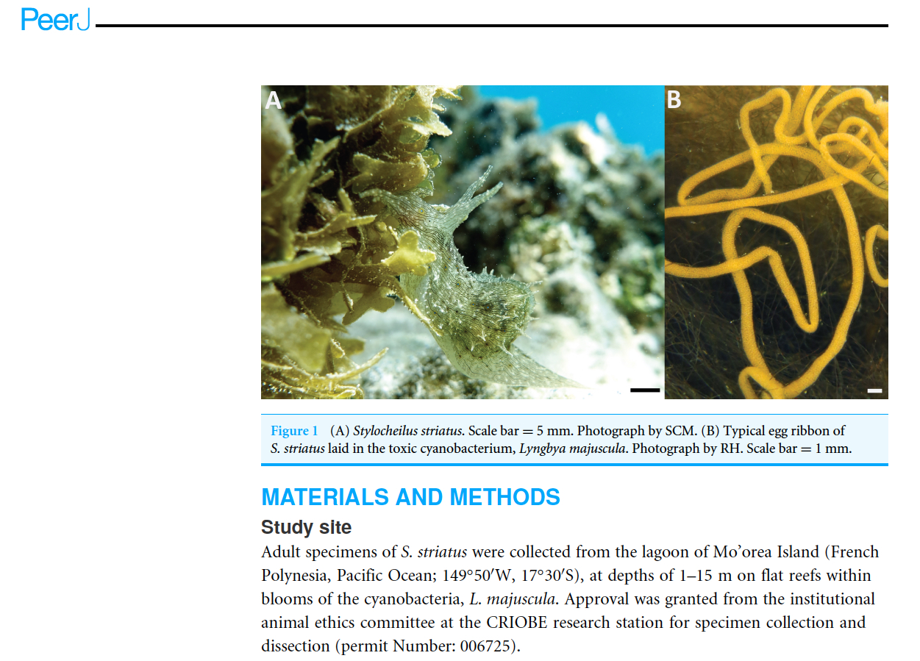

Slide 25
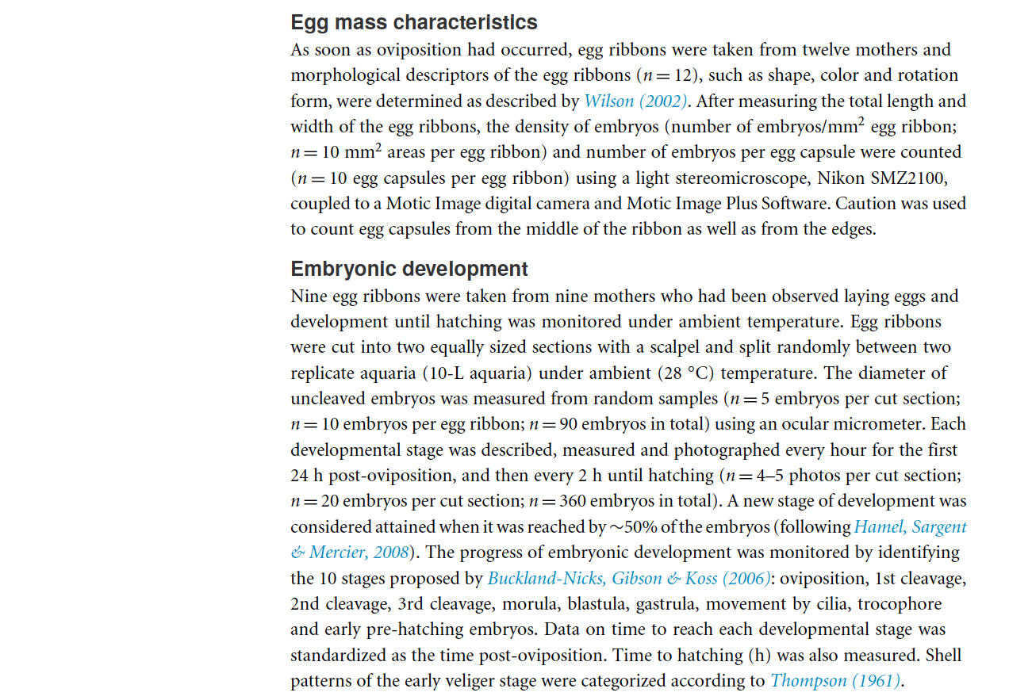

Slide 26
5. Gantt chart
You have 12 months to complete your dissertation.
Effective project planning is an important part of the dissertation process.
Plan carefully, and start now.
It will take longer than you think.
An effective way to plan and schedule your tasks is to produce a Gantt chart - a type of bar chart that illustrates a project schedule.
Gantt charts illustrate the start and finish dates of the dissertation and summary
elements of the project and can be produced in MS Excel or MS Word.

Slide 27
Example Gantt chart
Task | Month 1 June 2017 | Month 2 July 2017 | Month 3 Aug 2017 | Month 4 Sept 2017 | Month 5 Oct 2017 | Month 6 Nov 2017 | Month 7 Dec 2017 | Month 8 Jan 2018 | Month 9 Feb 2018 | Month 10 Mar 2018 | Month 11 April 2018 | Month 12 May 2018
Literature review
Experimental design
Fieldwork
Data compilation
Data analysis
Progress report
Progress meeting 1
Poster presentation
Writing
Progress meeting 2
Submit draft dissertation
Progress meeting 3
Writing
Submit final dissertation

Slide 28
6. Ethics and health and safety
Ethics (covered by Dr Sara McDowell in session 2), safety and risk assessment are important aspects of the research planning process.
You cannot do research that is unsafe, illegal or ethically unsound (Parsons and Knight , 2015).
The research proposal represents the stage in the dissertation process where you need to address your plans and identify potential safety or ethical issues involved in your research.
All students must complete the risk assessment and ethical approval sections of the research plan, and this should form the basis for some discussion at Meeting 1 with your supervisor.

Slide 29
Two contrasting projects – what are the risks?
Project 1 Noah Harris: Investigating links between geological complexity and biodiversity
Will involve fieldwork on an exposed rocky shore
Project 2 Rebekah Conn: Investigating scour at fully-submerged shipwreck sites
Will involve no fieldwork, and lots of time interpreting acoustic remotely sensed data

Slide 30
Some projects have obvious ethics or safety issues:
For example, working on the foreshore presents risks associated with data collection in a sometimes inhospitable environment.
Working in a laboratory with hazardous substances poses significant risks.
Operating for long periods in front of computers without taking defined breaks can lead to eye and back strain.
If your dissertation involves working with children or vulnerable adults, then ethical considerations must be considered.

Slide 31
Ulster University: Health and Safety Guidance
Students should familiarize themselves with, and abide by, the Ulster University procedures, guidance and forms related to managing Health and Safety.
These procedures should inform the risk assessment section of your research proposal.
Of particular interest are the documents relating to fieldwork, display screen equipment, manual handling, and the control of substances hazardous to
health.
http://www.ulster.ac.uk/healthandsafety/procedures_safety.html

Slide 32
Ulster University: Policy for Governance of Research Involving Human Participants
Students conducting research involving human participants should familiarise themselves with, and abide by, the Ulster University policy for the governance of research involving human participants.
This policy can inform the ethics section of your research proposal.
http://www.ulster.ac.uk/__data/assets/pdf_file/0010/75637/HumanParticipantsPolicy.pdf

