Slide 1
The Dissertation Process
School of Geography and Environmental Sciences
Ulster University
Dr Rory Quinn
Dissertation Co-ordinator

Slide 2
EGM 303/350/351 Field School Modules
Weeks 1-6: Dissertation preparation
Week 1 & 2 Dissertation preparation sessions
Week 3 Identify a topic and supervisor
Week 4 - 6 Develop and submit a dissertation proposal on the topic
Weeks 7-12: Field school preparation and field schools
Week 7 - 10 Field school preparation
Week 11 Field Schools
ES Richard Douglas
GEO Colin Breen
MS Rory Quinn

Slide 3
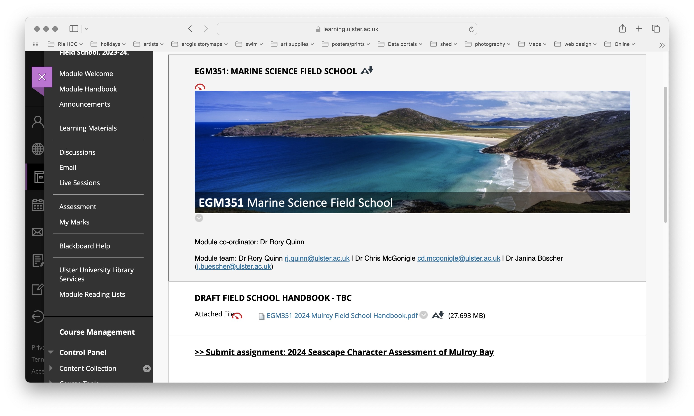
Check Field School Module Area on Blackboard – e.g. Marine Science

Slide 4
Introductory sessions - Year 2
Week 1
Session 1: The dissertation process (Dr Rory Quinn)
Session 2: Research ethics and H&S (Dr Sara McDowell)
Session 3: Library session RefWorks and lit searches (UU Library Staff)
Monday: 11.15-12.45, IT Suite Library Surnames: Andrich to McAteer
Week 2
Session 4: The research proposal (Dr Rory Quinn)
Session 5: Library session RefWorks and lit searches (UU Library Staff)
Monday: 11.15-12.45, IT Suite Library Surnames: McCann to Wright

Slide 5
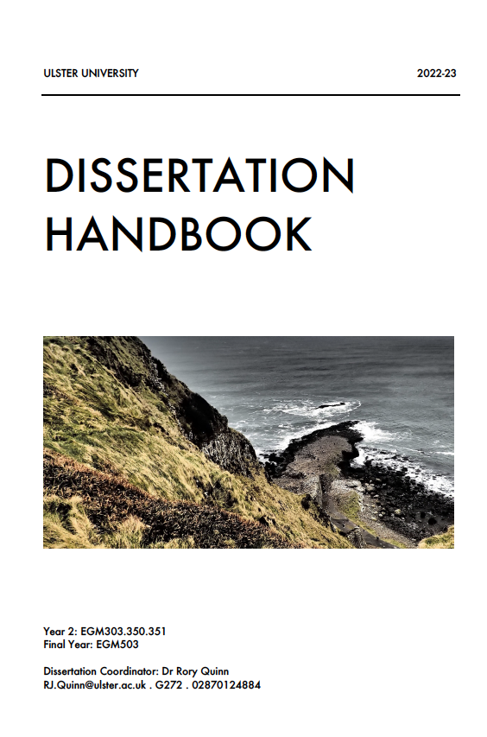
Module Handbook
GES Dissertation Support Area

Slide 6
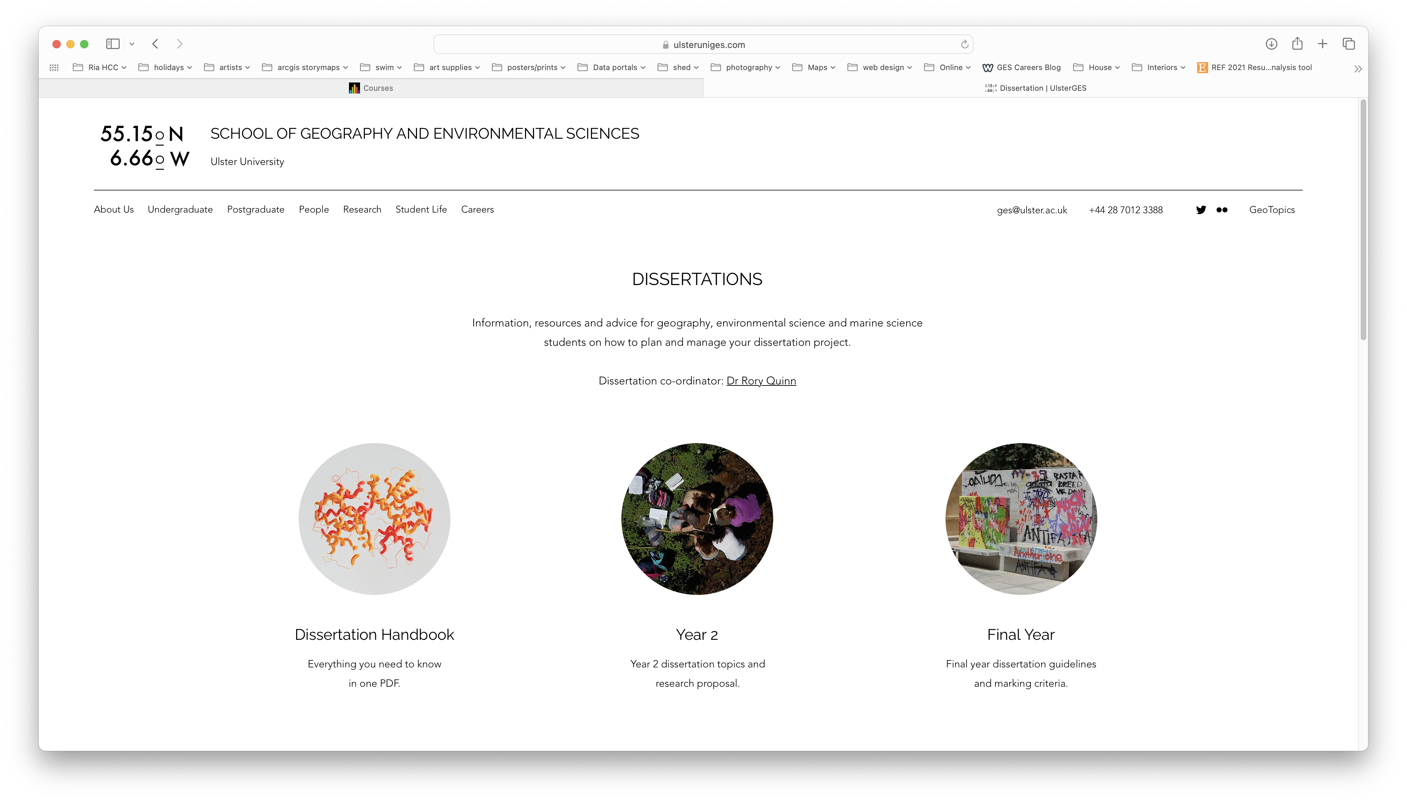
https://www.ulsteruniges.com/dissertation

Slide 7
What is a dissertation?
A dissertation as a form of assessment differs from other module assessments.
The expectation is that you, the learner, take responsibility for your own learning and that you produce a dissertation (formatted as a scientific journal paper) in your final year.

Slide 8
Year 2 Semester 2 Research Methods and Field School
EGM303/350/351: Dissertation Research Proposal
Year 3 Semester 1 Research and Professional Skills
EGM534: Progress Report and Poster
Year 3 Semester 2 Dissertation Module
EGM503: Dissertation

Slide 9
Key text
To plan ahead and provide a focus for your dissertation, you should regularly consult and ideally own a copy the key text.
Copies are available in the library and to buy online for approximately £30.
Parsons, T. and Knight, P.G., 2015, How to do your dissertation in geography and related disciplines, Routledge.

Slide 10
Dissertation topic and supervisor
In semester 2 of year 2, you identify a dissertation topic and supervisor, and submit a research proposal in preparation for the final year dissertation module.
The key to a successful dissertation is to choose a project with clear focus and one that will sustain your interest for a minimum of 12 months.
The project should be designed to either collect primary data or use existing (secondary) data to address a clear research question.

Slide 11
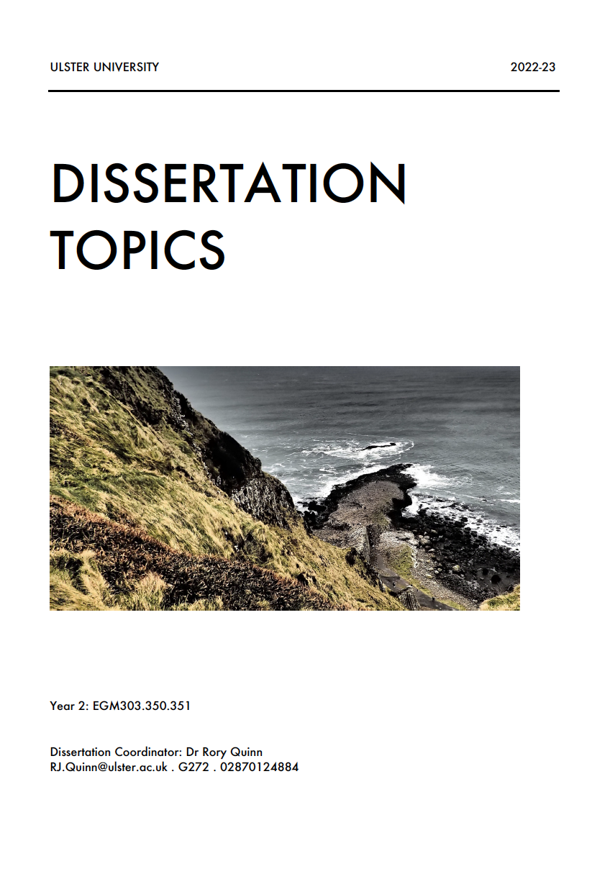
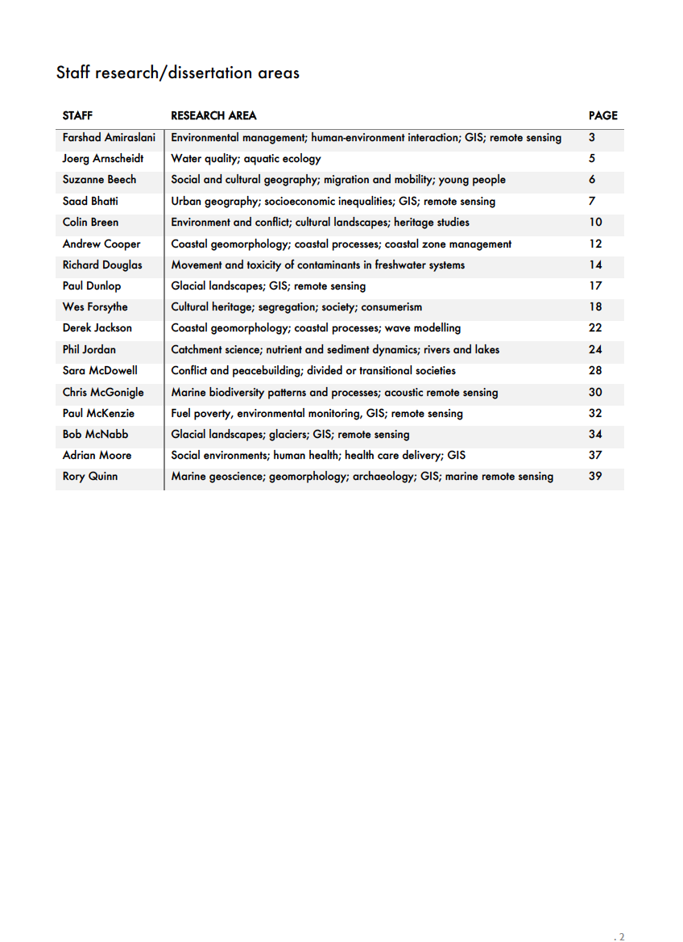
Dissertation topic and supervisor
To help in the process, we have compiled a list of dissertation projects with two key references per project to get you started:

Slide 12
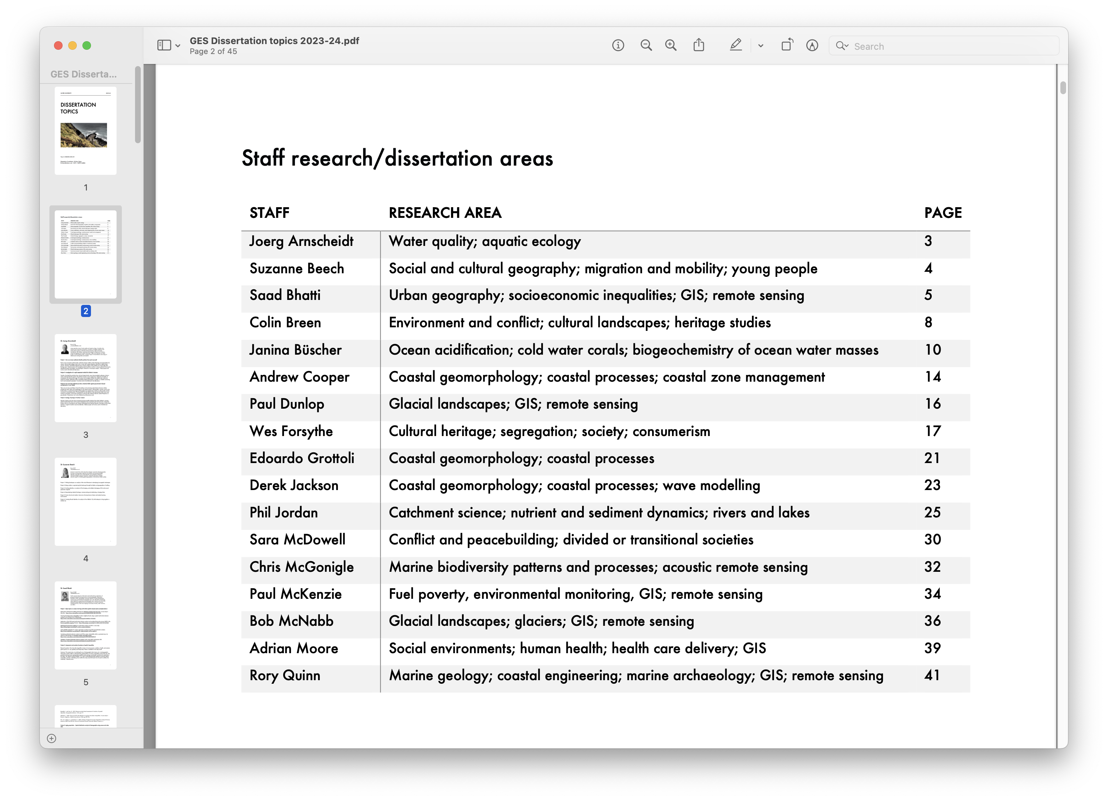

Slide 13
The role of your supervisor
Although the dissertation is essentially an independent piece of work, students are supported by a member of staff who acts as supervisor.
Supervisors may be able to give advice on practical issues such as: the subject and title of the dissertation, its organization and structure, and on source material and a short bibliography to get you started.
Supervisors can also be expected to comment upon research proposals, literature reviews and and a first draft of your dissertation.
However, a dissertation is intended to demonstrate students’ ability to work on their own, and supervisors are not expected to direct your work.

Slide 14
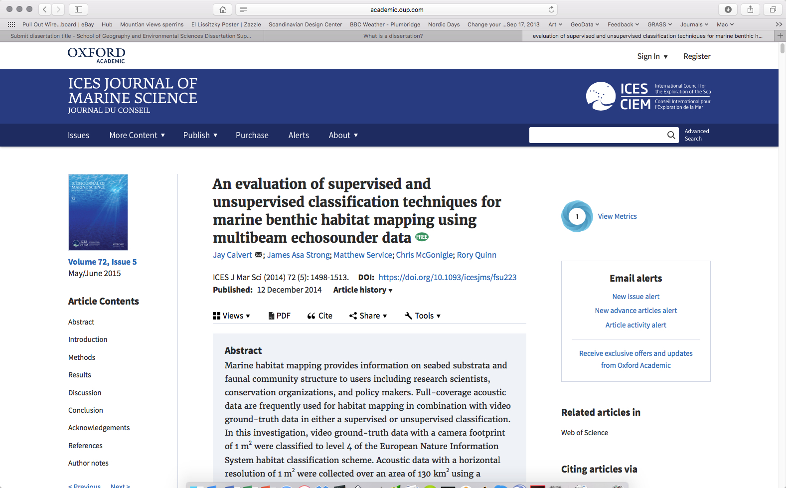

Slide 15
What do you need to do next?
Read dissertation topics
Read the recommended reading
Contact a potential supervisor by email and arrange a chat
Discuss the topic
Agree the topic
E-mail Rory Quinn with title and supervisor (week 3)
Each supervisor will supervise a maximum of 7 UG/PG dissertation students, so act sooner rather than later.

